Slide 1
MINI-PROJECT
Analysis on San Francisco City Facilities and Sub Facilities
Shrutiya M (PES1201700160)
Tejaswini A (PES1201700740)
Shubha M (PES1201701540)

Slide 2
INTRODUCTION
The chosen dataset contains information about San Francisco’s city facilities.The analysis carried out gives insights into the various different public facilities available in SF city, their location, how well distributed they are, their ownership, their governance and their spread.
Dataset: It is a public dataset meant to be a living reference for SF city obtained from Kaggle. It contains 1701 rows and 15 columns out of which 7 are numerical columns and 8 are categorical columns. Here, 4 columns have certain missing values/NAN.
Hence, several data cleaning steps (data pre-processing) were performed to obtain a reliable dataset.
DATASET:https://www.kaggle.com/san-francisco/sf-city-facilities-and-sub-facilities/version/50

Slide 3
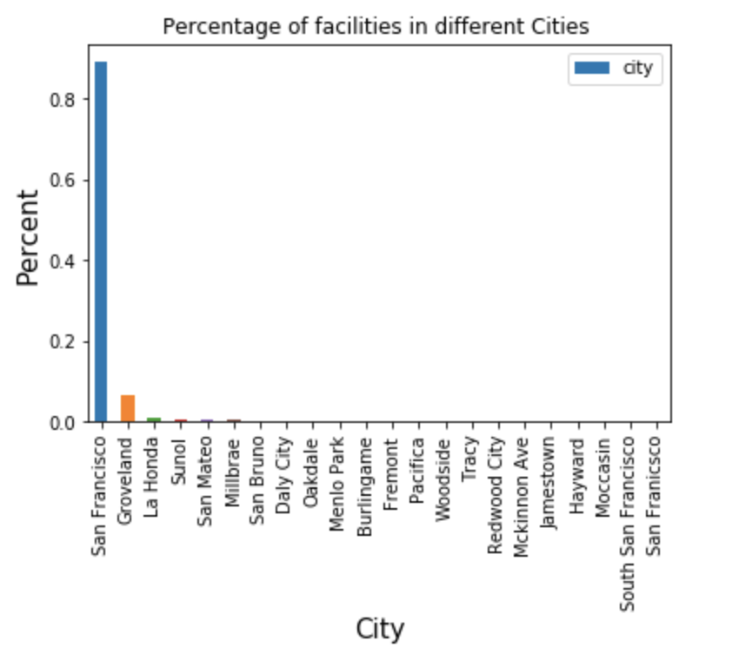
DATA CLEANING
Unnecessary column such as ‘geom’ is dropped as it contains repeated data (latitude and longitude are already present as separate columns) and is not useful in making useful conclusions.
Column such as ‘city_tenants’ having more than 90% data as missing values is dropped as they don’t account for making correct conclusions.
This dataset is used to draw conclusions on SF city and hence data about other cities become irrelevant and misleading. Hence they are treated as outliers and are removed. Only rows containing the ‘city’ San Francisco are extracted.

Slide 4
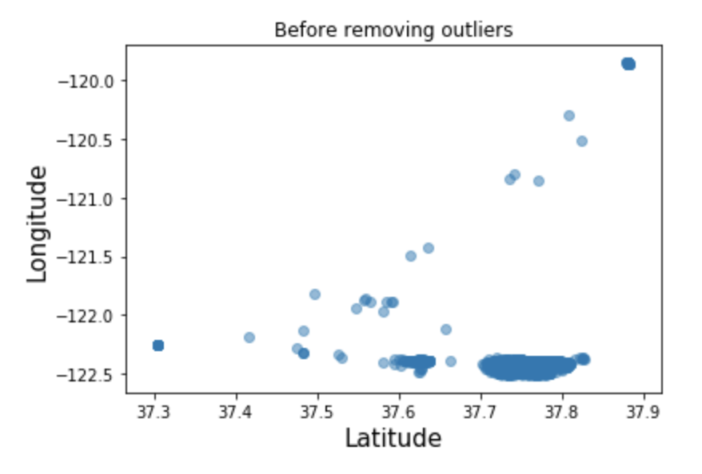
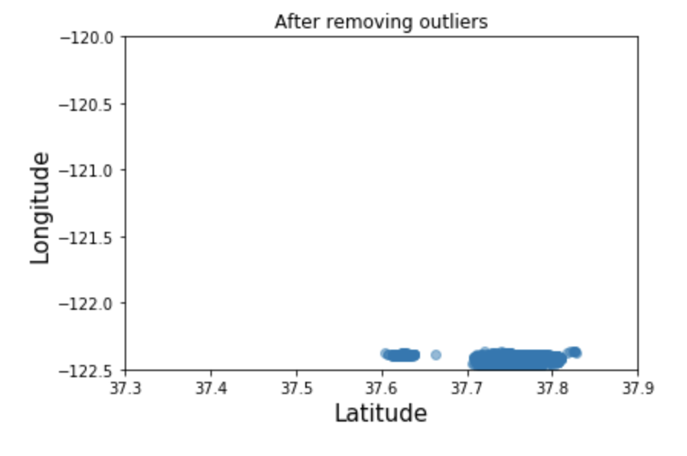
DATA CLEANING
The outliers can be clearly determined using latitude and longitude.
It is very important to replace missing values with the appropriate values.Categorical NAN values are usually replaced with the previous values. However, the column ‘block_lot’ here is independent MAR(missing at random) and hence cannot be replaced by any value.
The NAN values in the column ‘owned_leased’ (categorical) is replaced by the previous values.
Numerical data is most often replaced with a measure of central tendency (mean, median, mode) appropriately. Here, the NAN values in ‘supervisor_district’ are replaced with the mode as this column is filled with unique, discrete identity numbers to denote the board of supervisor district where the facility is located.

Slide 5
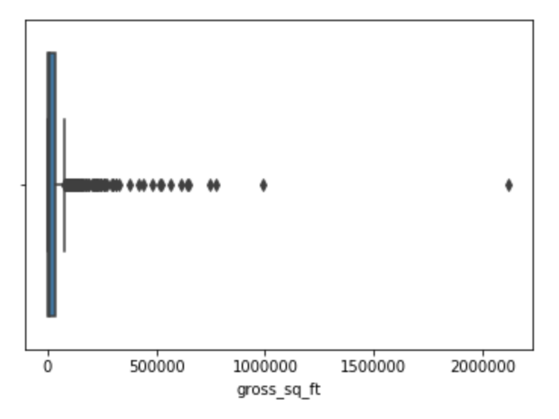
DATA CLEANING
Since there are many outliers in ‘gross_sq_ft’, mean cannot be used to replace the missing values.Therefore, NAN values in ‘gross_sq_ft’ are replaced with the median.
The ‘zip_code’ column must contain only 5 digit codes and hence rows that do not contain 5 digit codes are removed (here, 1 row) as it leads to wrong conclusions.
Interpolation:It is the process of estimating values between two points. script.interpolate.interp1d is used to achieve this. Here, x is taken as the latitude and y is taken as the longitude and then interpolated. With this, y value can be estimated with any value of x in the range.

Slide 6
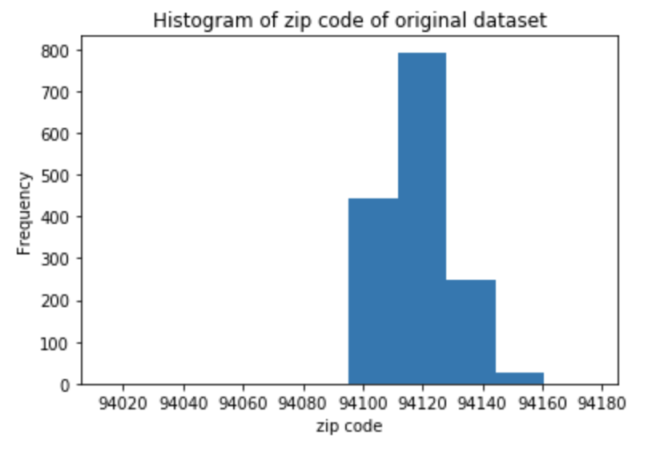
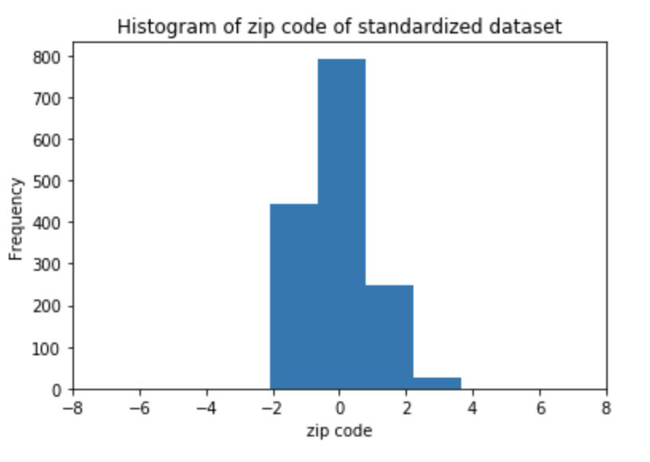
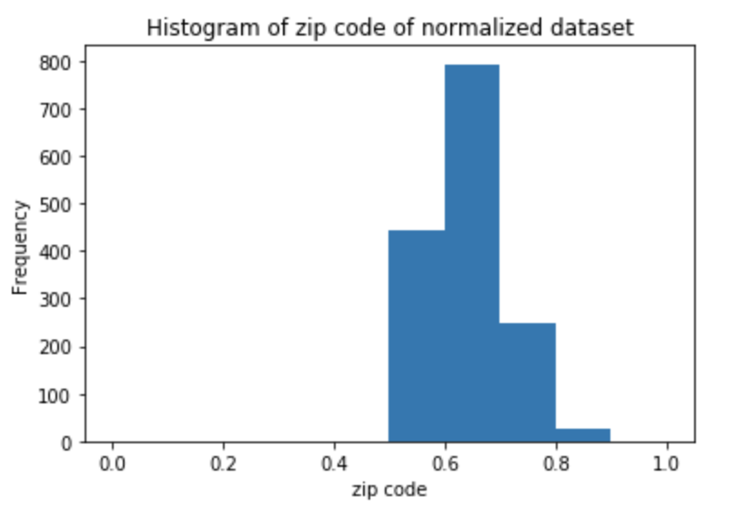
NORMALIZATION AND STANDARDIZATION
Normalization is a rescaling of the data from the original range so that all values are within the range of 0 and 1. Standardizing a dataset involves rescaling the distribution of values so that the mean of observed values is 0 and the standard deviation is 1.
It makes the data consistent and stable. Data is transformed to comparable scales and becomes more precise.The contribution of all the variables to the variance becomes clearer.
Hence, it is a very important step as it converts data into a common format which makes analysis easier.
The column ‘zip_code’ is plotted as a histogram. The X-axes clearly indicate the range of original, normalized and standardised data.The data is not normal, though it can be perceived as very slightly resembling normal.

Slide 7
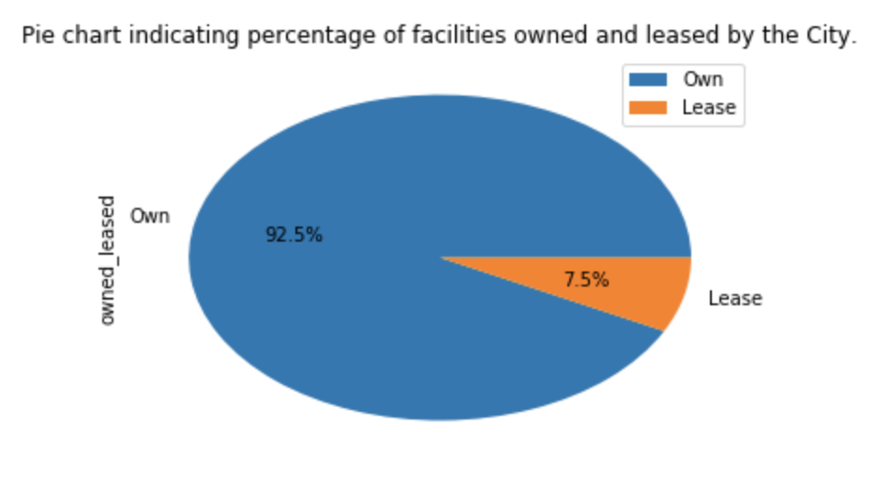
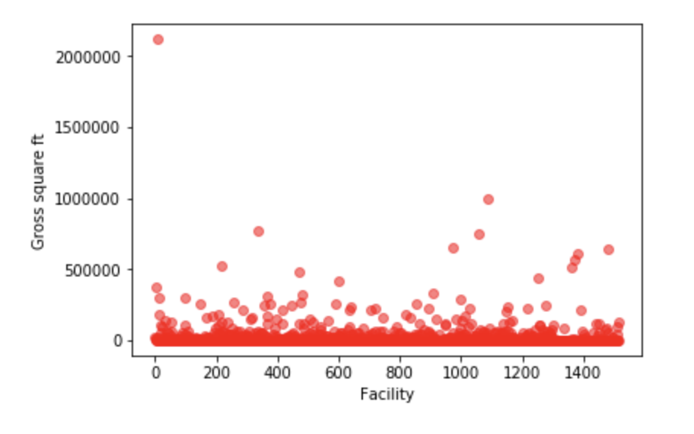
DATA VISUALISATION
Data visualisation is an important process that visually represents data to help identify patterns and trends.We plot several graphs and charts to identify important features about SF city facilities.
The pie chart of ‘owned_leased’ shows that 92.5% of the facilities are owned by the city and 7.5% is leased. This shows that majority of the facilities are owned by the city and the city is well facilitated.
The scatter plot of gross area of each facility (in sqft) in the city clearly shows that most of them have an area less than 250,000 sqft with the presence of several outliers some even having an area close to 2,000,000 sqft. This shows that a significant part of SF city is dedicated to accommodate public facilities

Slide 8
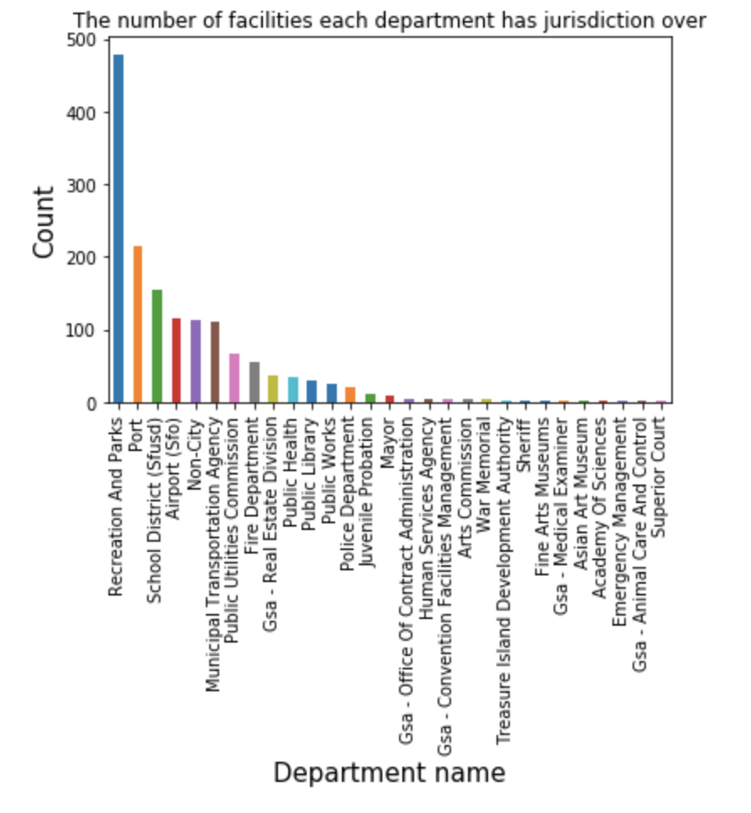
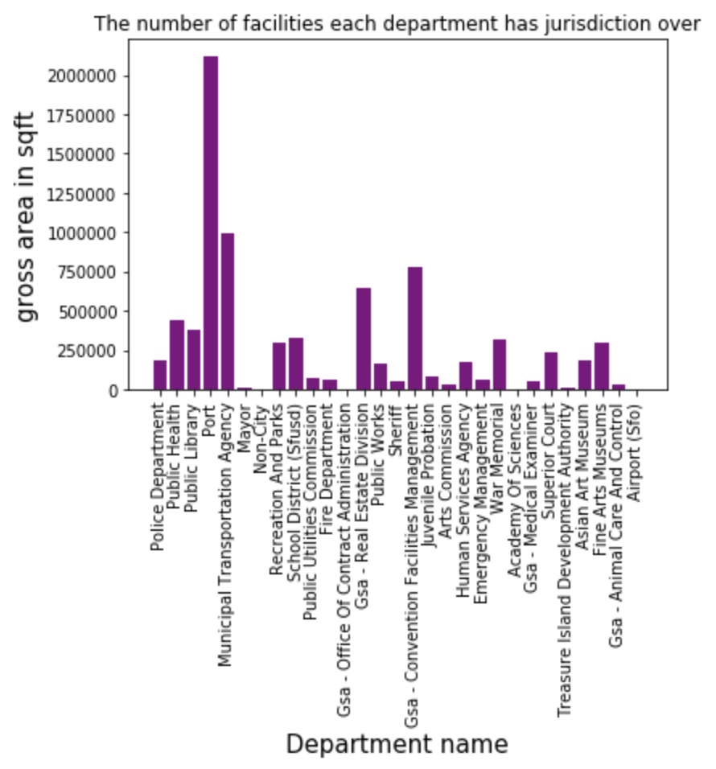
DATA VISUALISATION
This bar chart depicting the the number of This bar chart shows the gross area facilities each department has jurisdiction occupied by the different departments. over clearly shows that the most number Even though recreation and parks are of facilities available are for recreation and highest in number, they don’t occupy the parks, followed by ports and then schools highest space. Maximum area is occupied .This shows that these facilities are the by port followed by transportation.This ones used by most people and hence are shows that there is low or no correlation highly significant and more in number. between the number and area.

Slide 9
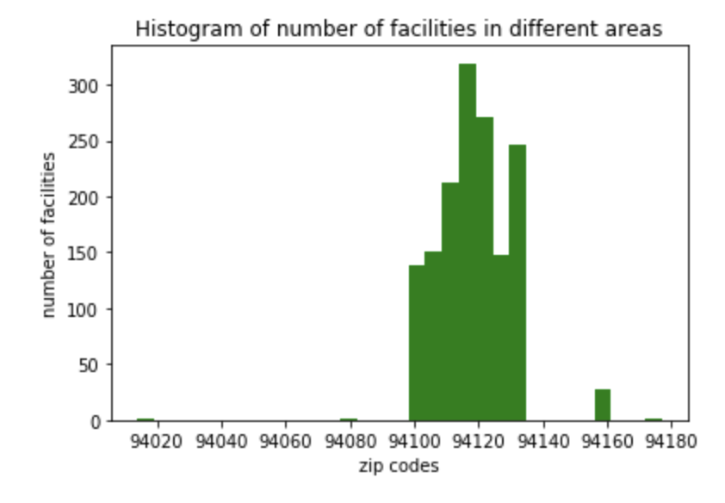
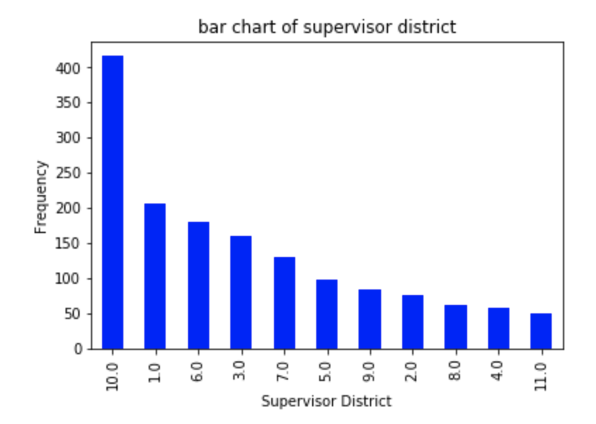
DATA VISUALISATION
This is a histogram of ‘zip_codes’ which This is a bar chart showing information represents the number of facilities in the about the supervisor district allotted for areas represented by zip codes. This the different facilities.This graph represents the spread of the the facilities represents the governance of the throughout the city. It clearly shows that various facilities.This also gives us most of the facilities are present in insights about which board of areas with zip codes between 94100 and supervisors take care of maximum 94140 peaking especially in areas near facilities.Here supervisor district 10 94120. Takes care of almost double the number of facilities than other districts.

Slide 10
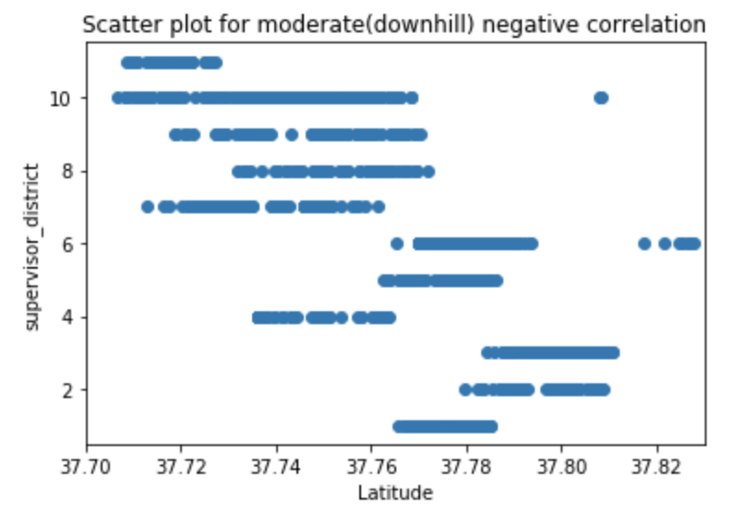
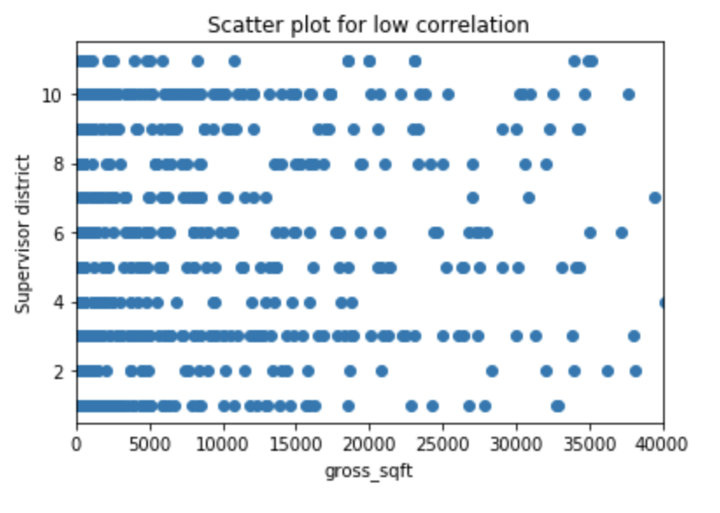
CORRELATION
Correlation is a statistical measure that indicates the extent to which two or more variables fluctuate together.After obtaining the correlations between the various fields(using corr( ) function), it was observed that:
‘latitude’ and ‘supervisor_district’ have the highest correlation in our dataset with a coefficient of -0.616 (moderate-strong). This is clearly accurate as the the board of supervisor district is allotted based on the location of the facilities.
‘supervisor_district’ and ‘gross_sq_ft’ have the least correlation in our dataset with a coefficient of -0.008 (non-linear/weak). This is clearly accurate as the supervisor district absolutely does not depend on the gross area of the facilities and rather depends on the location.

Slide 11
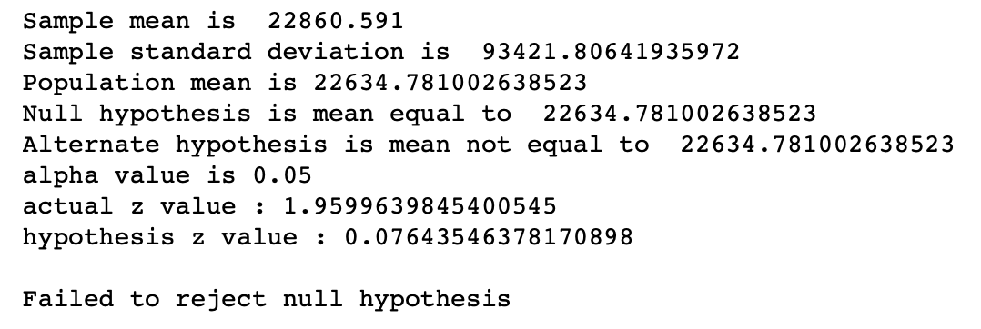
HYPOTHESIS TESTING
Hypothesis tests are statistical procedures that evaluate two mutually exclusive statements about a population to draw conclusions.
In our dataset, we conducted a two tailed hypothesis test on ‘gross_sq_ft’ by taking a sample from the population.The population mean was found out to be 22634.78 sqft.
Null hypothesis H0: μ = 22634.78 Alternate hypothesis. H1: μ ≠ 22634.78
The actual z-score (critical value) was calculated for a significant level of 5% (α=0.05). And since the z-score calculated for the hypothesis testing (from the sample) was not present in the rejection region, we fail to rejected the null hypothesis.

Slide 12
CONCLUSION
We understood that data cleaning and preprocessing is absolutely necessary to come up with accurate inferences about the dataset.
We also inferred from the various different types of data visualisation that SF city has a large number of public facilities for its inhabitants mostly owned by the city. And that these facilities are spread over a large area, and that they are efficiently governed by specific supervisor districts. We also saw their distribution across various departments and which department was given more importance. And hence we can fairly conclude that SF is a well facilitated city.
THANK YOU

